Slide 1
Natural Langauge Generation

Slide 2
Introduction
Natural language generation is used to generate language from structured data.
It can be applied in Chatbot and text-to-speech systems.

Slide 3
According to Gartner, 25% enterprises will be using NLG systems.

Slide 4
Natural language generation is completely opposite to Natural Langauge understanding.
For example, the weather in …….. Location is ……. Degrees.

Slide 5
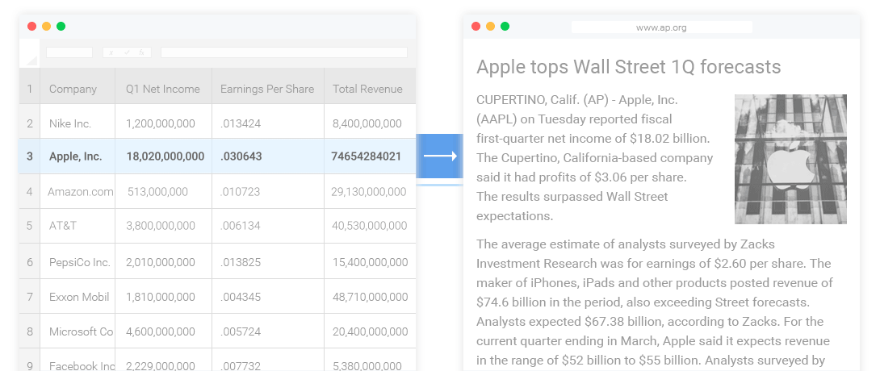
Example

Slide 6
Phases
Content determination
Document structuring
Aggregation
Lexical choice
Referring experssion generation
Realization

Slide 7
Phases of NLP System
NLU understands language and based on syntax, semantics and context, entities are created.
NLP process text into structured data.
NLG generates structured data into language form (text/speech).

Slide 8
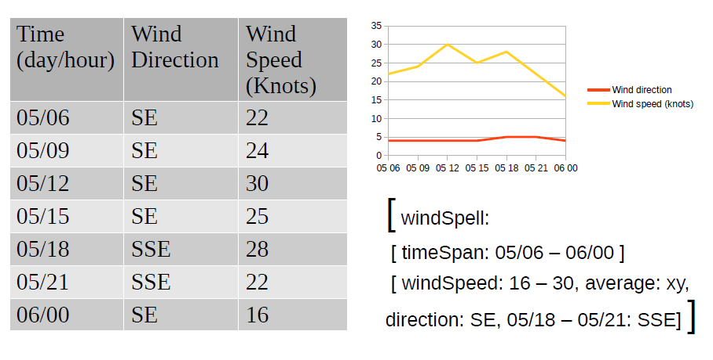
Example

Slide 9

Example
Source: NLG Course (Moore)

Slide 10
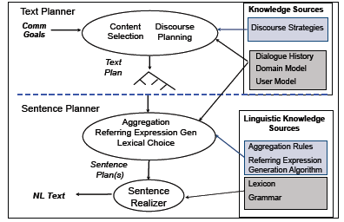
Source: NLG Course (Moore)

Slide 11
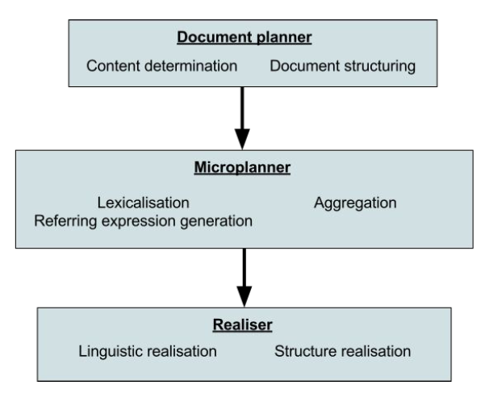
Source: NLG Course (Mark Granroth-Wilding)
https://courses.helsinki.fi/sites/default/files/course-material/4476853/introduction_to_nlg.pdf

Slide 12
Input to NLG System
(k, c, u, d) - tuples
K- knowledge base
C- communicative goal
U- user base
D- discourse analysis

